Slide 1
UBMK’25
Comparison Of Recommendation Models Based On GraphSAGE, Heterogeneous Graph Transformer And Heterogeneous Graph Attention Network For Educational Recommendation In Heterogeneous Knowledge Graphs
Valiya Ramazanova¹, Madina Sambetbayeva¹², Sandugash Serikbayeva¹, Aigerim Yerimbetova²
¹L.N. Gumilyov Eurasian National University, Department of Information Systems, Kazakhstan
²Institute of Information and Computational Technologies of the Committee of Science of the Ministry of Science and Higher Education, Kazakhstan

Slide 2
Introduction
Modern research demonstrates the potential of graph neural networks (GNNs) for modeling complex inter-entity relationships in heterogeneous graphs. GNNs are most actively used in link tasks prediction – predicting the presence or probability of a connection between two nodes. [1-2]
Link weight prediction is a relatively new problem compared to the link prediction problem [3] and uses mostly in simple relationships, like user-movie recommendations.
This study aims to fill these gaps by applying GNN to the problem of link weight prediction for a heterogeneous knowledge graph combining user or university educational program competencies; real IT vacancies on the hh.kz online recruitment website; and computer science courses from the Coursera platform.
Thus, a comparison of three recommendation models based on three types of GNNs: GraphSAGE, Heterogenous Graph Attention Network (HAN) [4] and Heterogeneous Graph Transformer (HGT) [5] is proposed.

Slide 3
Methodology
GraphSAGE can also work with heterogeneous graphs, and serves as a baseline for comparison. HANConv and HGTConv demonstrate high performance on public heterogeneous datasets (ACM, DBLP, IMDB), and scale well [5]. These architectures are used to generate low-dimensional vector representations for graph nodes.
The recommendation models consist of an encoder and a decoder.
A pointwise regression approach is used to train these recommendation models.
They were evaluated and compared using several quality metrics: RMSE, Precision@k, Recall@k, MAP@k and NDCG@k.

Slide 4
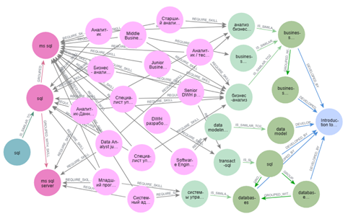
Methodology - Dataset
This study collected three datasets (competency maps of the university's educational program, vacancies from the online recruitment website hh.kz, and the Coursera MOOC), which were loaded into the graph DBMS Neo4j by their predefined ontologies and integrated at skills level via SBERT embeddings.
Edge type | Direction | Number of edges (train) | Number of edges (test)
IS_SIMILAR_TO | CUA → SkillMastered | 155 | 37
GROUPED_WITH_SKILL | SkillMastered - SkillMastered | 778
REQUIRE_SKILL | SkillMastered ← Vacancy | 7600
 | Vacancy → Skill | 17 749
IS_SIMILAR_TO2 | Skill → MSkill | 299
GROUPED_WITH_MSKILL | MSkill - MSkill | 2622
DEVELOPED_BY | MSkill → MCourse | 6074
metapath_0 | CUA → SkillMastered - SkillMastered → Vacancy → Skill → MSkill - MSkill → MCourse | 12 274 | 1886
metapath_1 | CUA → SkillMastered ↔ SkillMastered → Vacancy → Skill → MSkill → MCourse | 7659 | 1267
metapath_2 | CUA → SkillMastered → Vacancy → Skill → MSkill ↔ MSkill → Mcourse | 17 856 | 2710
metapath_3 | CUA → SkillMastered → Vacancy → Skill → MSkill → MCourse | 10 195 | 1615
CONNECTED_TO | CUA → MCourse (training labels) | 24 108 | 4875
Node type | Description | Number of nodes
 |  | from the training set | from the test set
CUA | User competence | 125 | 30
SkillMastered | Job skill already mastered by the user | 371
Vacancy | Job vacancy from the labor market | 3478
Skill | Unmastered skill required for job openings | 2676
MSkill | Online Course Skill | 791
MCourse | Massive Open Online Course (MOOC) | 877
Subgraph with paths between the starting node of the user competency CUA and the ending node of the course MCourse. Node colors: CUA – emerald, MasteredSkill – hot pink, Vacancy – pink, Skill – light green, MSkill – hot green, MCourse – blue.
p(CONNECTED_TO) = {score: y}, где y ∈[0,1]
Let k be the number of paths from CUA to the current MCourse,
kmax is the maximum number of paths from CUA to MCourse’_{max} in the current query for CUA
score = k / k_{max}

Slide 5
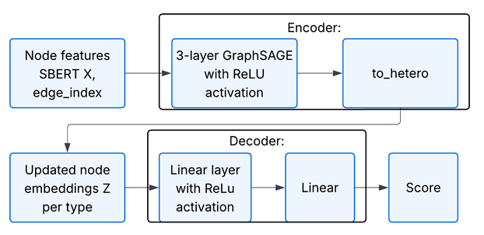
Models, Formulations and Techniques
The encoder of the first model is a three-layer heterogeneous graph neural network based on SAGEConv (GraphSAGE) with 64 hidden layers. At the output, a two-layer decoder is used, consisting of two linear layers, which transforms the combined embeddings of node pairs into a final connection score.

Slide 6
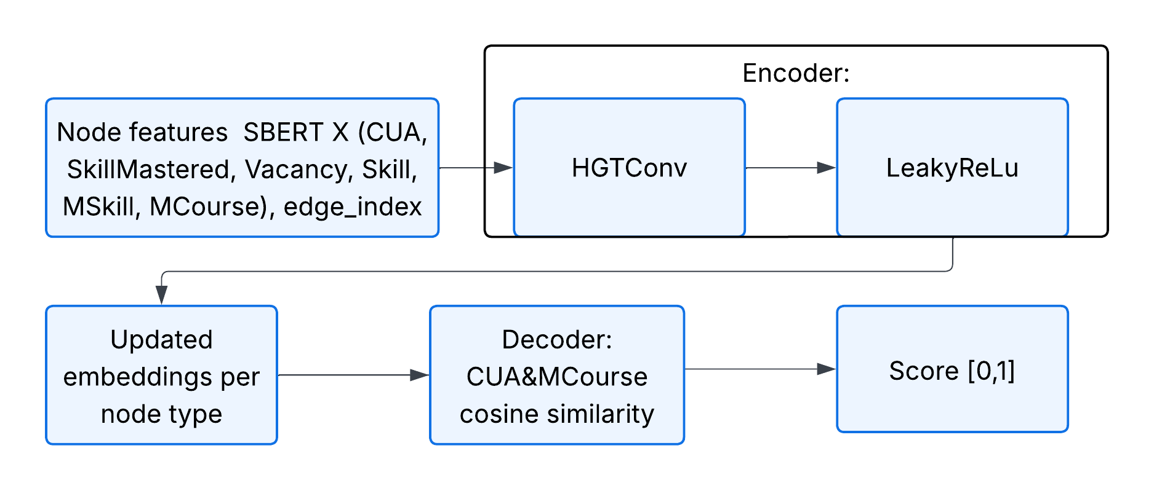
Models, Formulations and Techniques
The second model uses a linear layer with relu activation as an encoder, three HGTConv layers configured with 64 hidden channels and eight attention heads. The decoder does not contain trainable parameters: the final representations of the CUA and MCourse nodes are compared using cosine similarity scaled from the interval [-1, 1] to [0, 1].

Slide 7
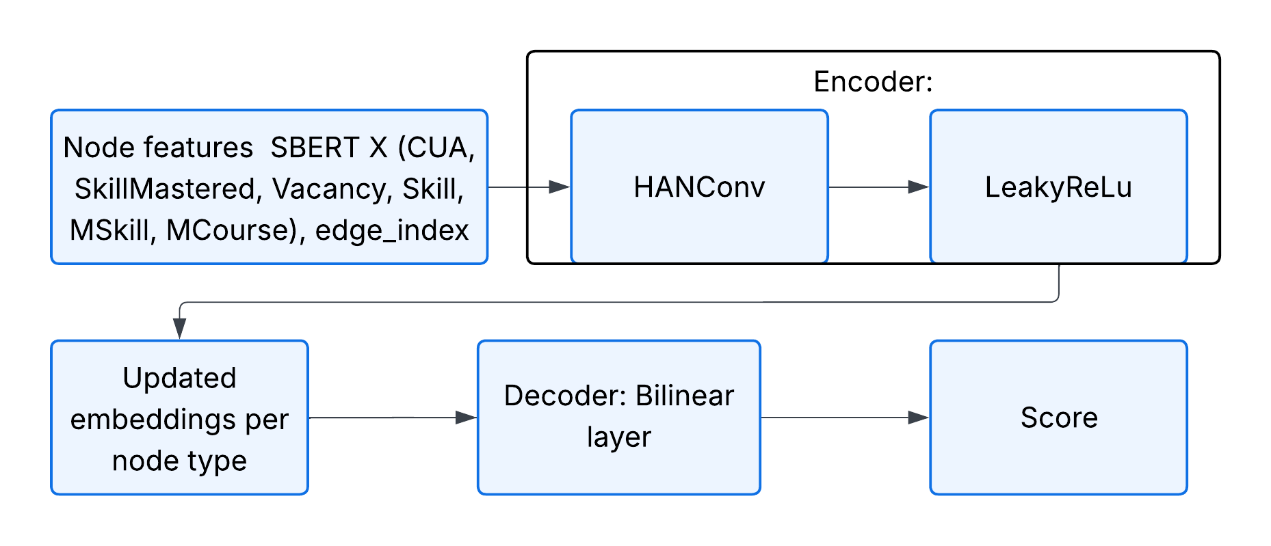
Models, Formulations and Techniques
The third recommendation model also consists of two key components: an encoder and a decoder. The encoder is the HAN Conv attention operator, which aggregates information across all given metapaths using a multi-headed node-layer and semantic-layer attention. The layer is configured with sixteen attention heads.

Slide 8
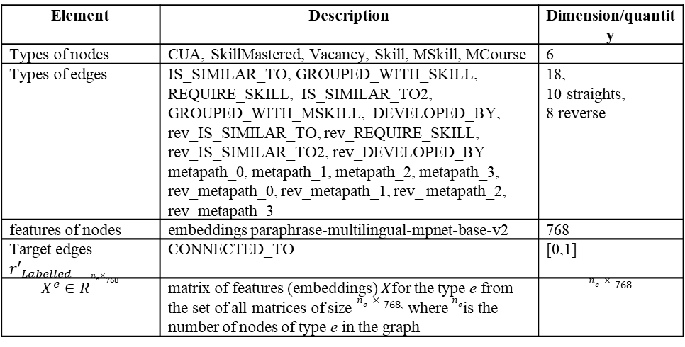
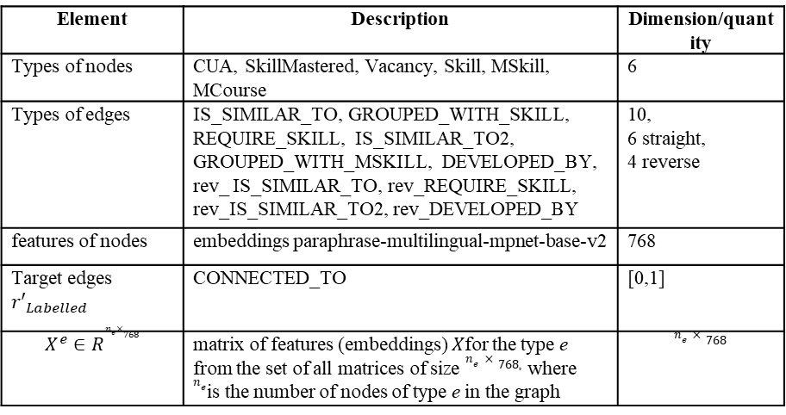
Experimental setting
TABLE IV. NODES AND EDGES FOR THE RECOMMENDATION MODEL WITH GRAPHSAGE LAYER AND HGT
TABLE V. NODES AND EDGES FOR THE RECOMMENDATION MODEL WITH THE HAN LAYER
Element | Description | Dimension/quantity
Types of nodes | CUA, SkillMastered, Vacancy, Skill, MSkill, MCourse | 6
Types of edges | IS_SIMILAR_TO, GROUPED_WITH_SKILL, REQUIRE_SKILL, IS_SIMILAR_TO2, GROUPED_WITH_MSKILL, DEVELOPED_BY, rev_ IS_SIMILAR_TO, rev_REQUIRE_SKILL, rev_IS_SIMILAR_TO2, rev_DEVELOPED_BY | 10, 6 straight, 4 reverse
features of nodes | embeddings paraphrase-multilingual-mpnet-base-v2 | 768
Target edges ${r′}_{Labelled}$ | CONNECTED_TO | [0,1]
$$X^{e}∈R^{n_{e}​×768}$$ | matrix of features (embeddings) $X$for the type e from the set of all matrices of size $n_{e}​×768$, where $n_{e}$is the number of nodes of type e in the graph | $$n_{e}​×768$$
Element | Description | Dimension/quantity
Types of nodes | CUA, SkillMastered, Vacancy, Skill, MSkill, MCourse | 6
Types of edges | IS_SIMILAR_TO, GROUPED_WITH_SKILL, REQUIRE_SKILL, IS_SIMILAR_TO2, GROUPED_WITH_MSKILL, DEVELOPED_BY, rev_IS_SIMILAR_TO, rev_REQUIRE_SKILL, rev_IS_SIMILAR_TO2, rev_DEVELOPED_BY metapath_0, metapath_1, metapath_2, metapath_3, rev_metapath_0, rev_metapath_1, rev_ metapath_2, rev_metapath_3 | 18, 10 straights, 8 reverse
features of nodes | embeddings paraphrase-multilingual-mpnet-base-v2 | 768
Target edges ${r′}_{Labelled}$ | CONNECTED_TO | [0,1]
$$X^{e}∈R^{n_{e}​×768}$$ | matrix of features (embeddings) $X$for the type e from the set of all matrices of size $n_{e}​×768$, where $n_{e}$is the number of nodes of type e in the graph | $$n_{e}​×768$$
The recommendation models were trained for 100 epochs using the Adam method with batches of 2000 edges. The mean squared error (MSE) between the predicted velocity and the true weight of the CONNECTED_TO edge is used as the loss function.

Slide 9
Results and Discussion
Dataset type | k | RMSE | Precision@k | Recall@k | MAP@k | NDCG@k
training | 5 | 0,1893 | 0,3858 | 0,1866 | 0,3042 | 0,5430
 | 10 | 0,1893 | 0,4071 | 0,3410 | 0,3517 | 0,6033
 | 15 | 0,1893 | 0,4165 | 0,5129 | 0,3991 | 0,6498
 | 20 | 0,1893 | 0,3730 | 0,5840 | 0,3991 | 0,6648
testing | 5 | 0,2211 | 0,3071 | 0,2169 | 0,2957 | 0,5397
 | 10 | 0,2211 | 0,2929 | 0,3021 | 0,3083 | 0,5900
 | 15 | 0,2211 | 0,3167 | 0,4394 | 0,3428 | 0,6379
 | 20 | 0,2211 | 0,2821 | 0,4770 | 0,3360 | 0,6503
EVALUATION OF THE RECOMMENDATION MODEL: GRAPHSAGE-BASED, HGT-BASED, HAN-BASED
The difference between the training and testing metrics of the recommendation model based on the GraphSAGE layer is small, which indicates that the generalization ability of the model is good. The main metrics have low scores, only NDCG shows an acceptable ranking result.
Dataset type | k | RMSE | Precision@k | Recall@k | MAP@k | NDCG@k
training | 5 | 0,0916 | 0,8372 | 0,5017 | 0,8613 | 0,9080
 | 10 | 0,0916 | 0,6690 | 0,6605 | 0,8309 | 0,9145
 | 15 | 0,0916 | 0,5841 | 0,7640 | 0,8321 | 0,9188
 | 20 | 0,0916 | 0,5142 | 0,8390 | 0,8300 | 0,9196
testing | 5 | 0,2098 | 0,5500 | 0,3053 | 0,5698 | 0,7159
 | 10 | 0,2098 | 0,4857 | 0,4229 | 0,5578 | 0,7414
 | 15 | 0,2098 | 0,4452 | 0,5154 | 0,5425 | 0,7588
 | 20 | 0,2098 | 0,4107 | 0,6223 | 0,5395 | 0,7728
The results based on the HGT layer demonstrate acceptable performance of the model with the HGT layer, especially for two ranking quality metrics MAP@k and NDCG@k.
Dataset type | k | RMSE | Precision@k | Recall@k | MAP@k | NDCG@k
training | 5 | 0,1549 | 0,4637 | 0,2070 | 0,3788 | 0,5715
 | 10 | 0,1549 | 0,4310 | 0,3426 | 0,3955 | 0,6123
 | 15 | 0,1549 | 0,4012 | 0,4663 | 0,4032 | 0,6435
 | 20 | 0,1549 | 0,3726 | 0,5579 | 0,4096 | 0,6632
testing | 5 | 0,2039 | 0,4000 | 0,2328 | 0,3873 | 0,5812
 | 10 | 0,2039 | 0,3107 | 0,3065 | 0,3446 | 0,6140
 | 15 | 0,2039 | 0,2786 | 0,3620 | 0,3397 | 0,6332
 | 20 | 0,2039 | 0,2661 | 0,4198 | 0,3400 | 0,6523
HAN layer-based ranking model, NDCG@k shows a more stable behavior. Other metrics have low scores

Slide 10
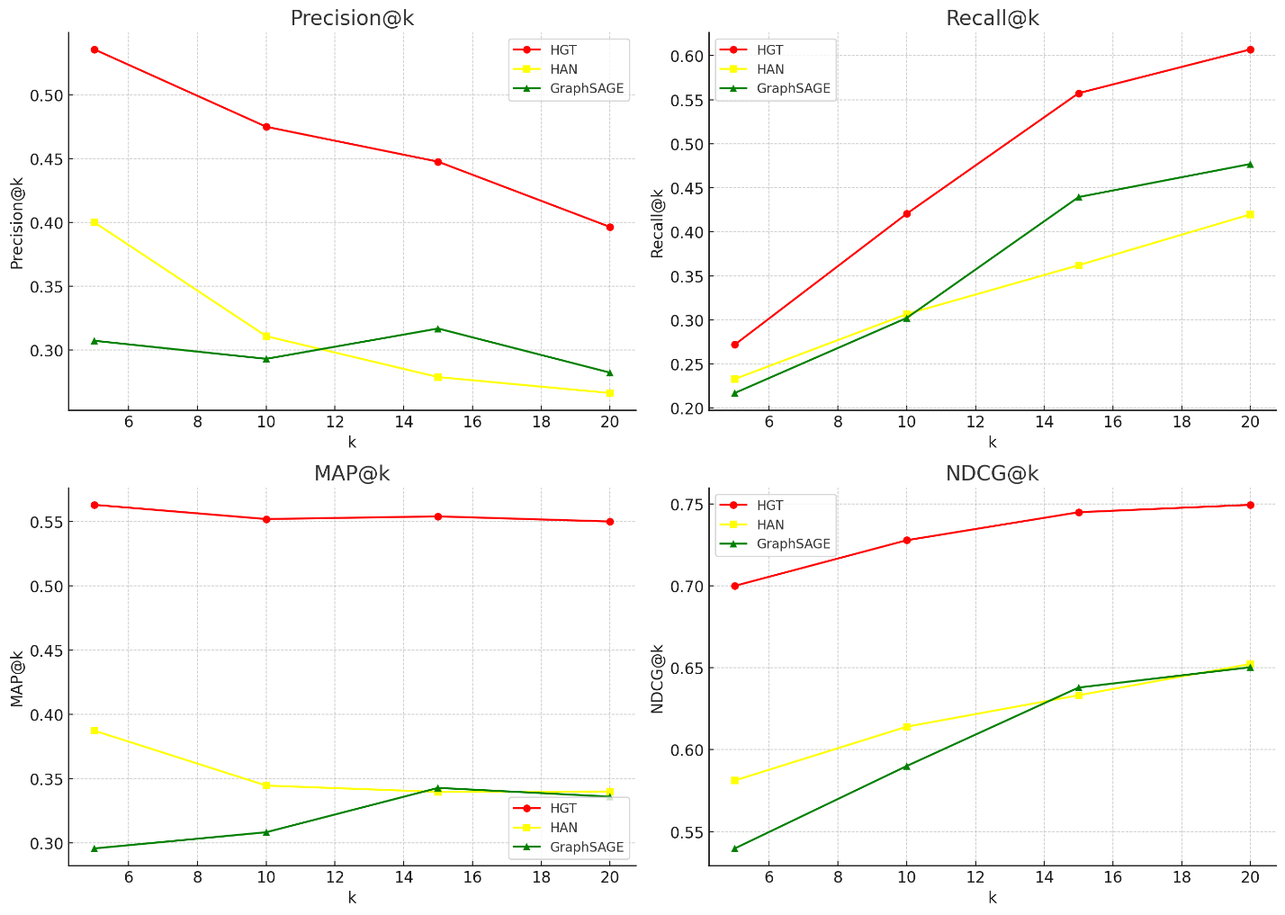
TABLE X. COMPARISON OF LINK WEIGHT PREDICTION MODELS
Results and Discussion
EVALUATION OF THE RECOMMENDATION MODEL: GRAPHSAGE-BASED, HGT-BASED, HAN-BASED
Author | Task | Datasets | Model | Graph view | Metrics | RMSE
[6] | Link attribute inference | IMDB ratings | HinSAGE | heterogeneous weighted graph | RMSE | 0,25
[7] | Link regression | IMDB ratings | SBERT, GraphSAGE | heterogeneous weighted graph | RMSE | 0,22
Our work | Link regression | User competencies- skills- vacancies- courses | SBERT, GraphSAGE | heterogeneous semi-weighted graph | RMSE, P, R, MAP, NDCG | 0,22
Our work | Link regression | User competencies- skills- vacancies- courses | SBERT, HAN | heterogeneous semi-weighted graph | RMSE, P, R, MAP, NDCG | 0,2
Our work | Link regression | User competencies- skills- vacancies- courses | SBERT, HGT | heterogeneous semi-weighted graph | RMSE, P, R, MAP, NDCG | 0,2
On the test dataset, the HGT model (red line) shows the best results.

Slide 11
Conclusions and Future Research
In this paper, we considered the problem of predicting the weights of connections between user competencies and online courses in the context of personalized educational recommendations on a heterogeneous knowledge graph.
To solve the problem, three recommendation models based on graph neural networks were developed and tested: GraphSAGE, HANConv, and HGTConv.
The experiments showed that the HGTConv-based model provides higher ranking quality for the key metrics MAP@k and NDCG@k on both the training and test subgraphs. The drawback was the prevalence of training data with low scores
Further research will be related to improving the recommendation model with the HGT layer and expanding the datasets.
The obtained results confirm the potential of using GNN models for recommending of educational courses on complex heterogeneous graph structure with long meta-paths.
This approach opens up prospects for the development of intelligent learning support systems that adapt to individual user needs and labor market requirements.

Slide 12
References
Gharizadeh, A., Abbasi, K., Ghareyazi, A., Mofrad, M. R. K., & Rabiee, H. R. (2024). HGTDR: Advancing drug repurposing with heterogeneous graph transformers. Bioinformatics, 40(7), btae349. https://doi.org/10.1093/bioinformatics/btae349
Liu, C., Han, Y., Xu, H., Yang, S., Wang, K., & Su, Y. (2024). A community detection and graph-neural-network-based link prediction approach for scientific literature. Mathematics, 12(3), 369. https://doi.org/10.3390/math12030369
Qin, M., & Yeung, D. Y. (2023). Temporal link prediction: A unified framework, taxonomy, and review. ACM Computing Surveys, 56(4), 1–40. https://doi.org/10.1145/3583565
Wang, X., Ji, H., Shi, C., Wang, B., Ye, Y., Cui, P., & Yu, P. S. (2019). Heterogeneous graph attention network. In Proceedings of the Web Conference 2019 (pp. 2022–2032). https://doi.org/10.1145/3308558.3313562
Hu, Z., Dong, Y., Wang, K., & Sun, Y. (2020). Heterogeneous graph transformer. In Proceedings of The Web Conference 2020 (pp. 2704–2710). https://doi.org/10.1145/3366423.3380027
StellarGraph. (n.d.). HinSAGE link prediction demonstration. Retrieved from https://stellargraph.readthedocs.io/en/stable/demos/link-prediction/hinsage-link-prediction.html
PyTorch-Geometric. (n.d.). Link regression on MovieLens. Retrieved from https://colab.research.google.com/drive/1N3LvAO0AXV4kBPbTMX866OwJM9YS6Ji2?usp=sharing#scrollTo=Ptk1J307IVn8

Slide 13
Appendices
Raw data: examples

Slide 14
Thank you for your attention

